Slide 1
Recipe Keeper App
CPSC 357 Final Project
Taylor Ropiequet

Slide 2
Introduction
Motivation
Consistent place to keep recipes that are gathered from various websites or social medias
Potential Users
Those who have an established recipe book they would like to digitize
Those who have a hard time keeping track of recipes

Slide 3
User Scenario
Busy college student living alone
Difficult to plan and think of meals for the week
Recipes scattered from notes to saved TikTok videos
Written recipes would get spilled on while cooking
Having recipes digitized in one place allows for easy meal planning and prep
Easy navigation/search based on what type of meal (breakfast, lunch, etc.)

Slide 4
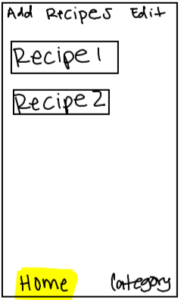
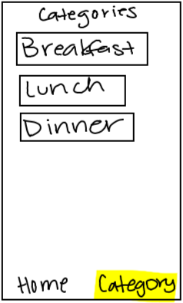
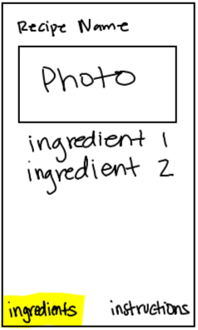
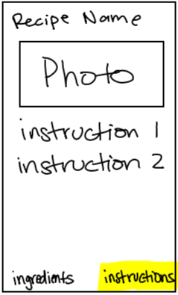
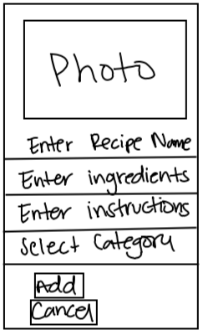
Prototypes
Home Tab Views
Recipe Detail Tab Views
Add Recipe View

Slide 5

Video Demo

Slide 6
Usability Heuristics
Consistency and Standards
Consistent icons
Icons understandable
Buttons/tabs stay in same spot throughout app
Aesthetic and Minimalist Design
Very minimal design
Nothing is cluttered
Information is displayed very clearly

Slide 7
IOS Design Principles
Consistency
Consistent Icons
User Control
Easy and understandable icons
Direct Manipulation
Buttons/tabs indicate their exact function
Aesthetics and Integrity
Clean and minimal design

Slide 8
Future Work
Import recipes from website
Favorite recipes
Upload photos
Search recipes

